Slide 1


Capstone Project 2015-2016
Computer Science Department
Texas Christian University
Big Data is a Big Deal!

Slide 2
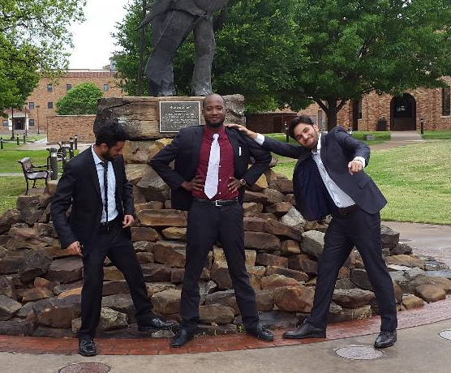

Frog-B-Data Team
Sushant Ahuja
  Project Lead
Cassio Cristovao
  Technical Lead
Sameep Mohta
  Testing Lead

Slide 3
Agenda
Project Overview and Goals
Milestones
Apache Hadoop
Apache Spark
Initial Testing
Recommender System
Clustering
Challenges
Questions
Notes:
Needs to be modified

Slide 4
Project Background
Big Data Revolution
  Phones, Tablets, Laptops, Computers
  Credit Cards
  Transport Systems
  0.5% of data stored is actually analyzed¹
Smart Data: Selection based on a pattern of behavior
  Google: I’m Feeling lucky
  Recommendation Systems
        Netflix, Amazon, Facebook
    1. Source: https://www.technologyreview.com/business-report/big-data-gets-personal/ Published in May 2013
Notes:
0.5% of data stored is actually analyzed¹ Using databases and sql providing actually valid data
Find good explanation for smart data – a selection based on a pattern of behavior (loan problem)
Google normal data search and I’m feeling lucky example

Slide 5


Goals
Performance Analysis
  Hadoop vs Spark
    Speed
    Size of data
    Efficiency
Validate feasibility
Predict data - recommendation systems
  ‘Big Data’ ‘Smart Data’
Notes:
Needs to be modified

Slide 6
Project Technologies
Java Virtual Machine
Eclipse IDE
Apache Hadoop
Apache Spark
Maven for Hadoop and Spark
Mahout on Hadoop systems
MLlib on Spark systems

Slide 7
Milestones
Iteration 1 15 December, 2015
Iteration 2 2 February, 2016
Iteration 3 3 March, 2016
Iteration 4 6 April, 2016
SRS 8 April, 2016
NTASC Presentation 16 April, 2016
Final Presentation 28 April, 2016
Complete Documentation 2 May, 2016
Notes:
Milestones with dates

Slide 8
Fall 2015
Project Selection
Iteration 1:
  Setting up Hadoop and Spark on 6 Linux machines
  Initial Software Tests
  Initial Documentation
    Project Plan v1.0
    Project Requirements v1.0
    Project Design v1.0

Slide 9
Spring 2016
Iteration 2:
  Cluster of nodes, Hadoop & Spark
  Starting to understand basic recommender algorithms
  Revision of all the documents to v2.0
Iteration 3:
  Recommendation System on Hadoop
  K-Means Clustering on Hadoop
  Revision of all the documents to v3.0

Slide 10
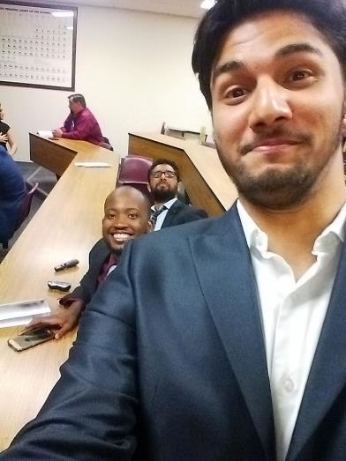
Spring 2016
Iteration 4:
  Recommendation System for Spark
  K-Means Clustering on Spark
  Improve Recommender’s Scalability and Reliability
  Final versions of documents
    Developer’s Manual
    User’s Manual

Slide 11

Our Cluster
Hadoop and Spark
  2 Clusters: 3 nodes each
    8 GB RAM
    500GB HDD
    Ubuntu 15.04
  Manager-Worker Architecture
    1 Manager
    2 Workers
M
W
W

Slide 12
Apache Hadoop
Framework for large-scale, data-intensive deployments
Open-source
MapReduce – Stream I/O style of data processing, created by Google
  Map – Filtering input line by line
  Reduce – Collecting and processing filtered data
Write-once storage infrastructure

Slide 13
Apache Hadoop
4 Dimensions – Volume, Velocity, Variety, Veracity
Both Structured (converted) and Unstructured
HDFS – Breaks up input data – Blocks
  Stores it on compute nodes (Parallel Processing)
Notes:
Explain structured and unstructured data
text separated by commas with no field names (such as name, age, title) – unstructured – we have a list of words separated by commas
create our own structure, NOSQL

Slide 14
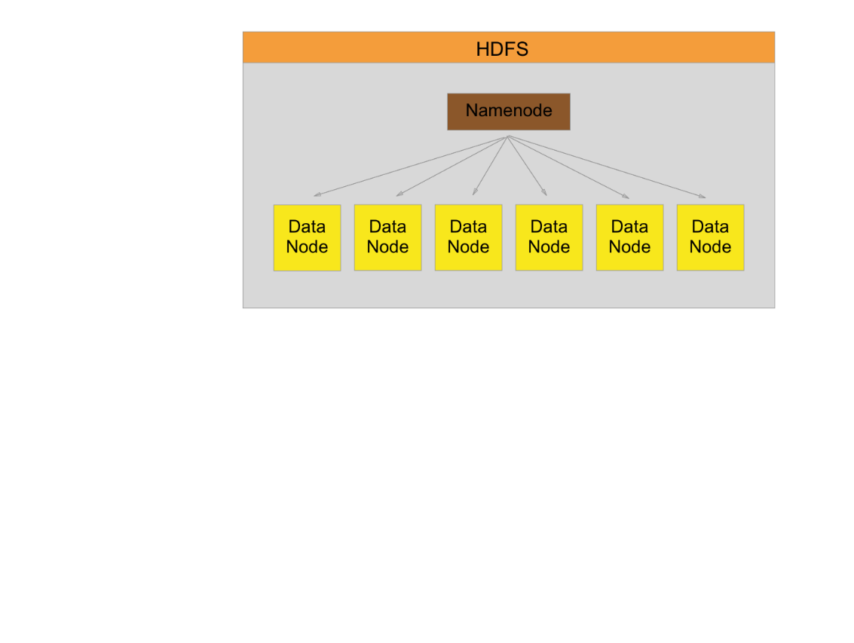
HDFS Segmentation

Slide 15
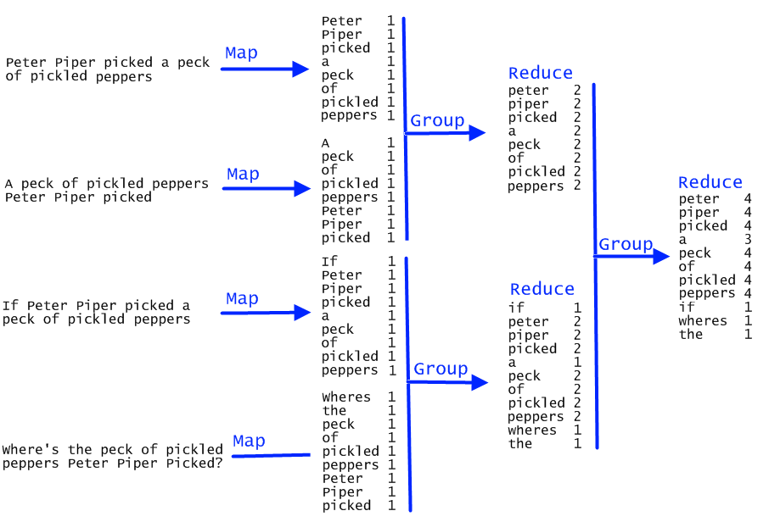
https://tarnbarford.net/static/journal/map-reduce_on_mongo/map-reduce-example.png

Slide 16
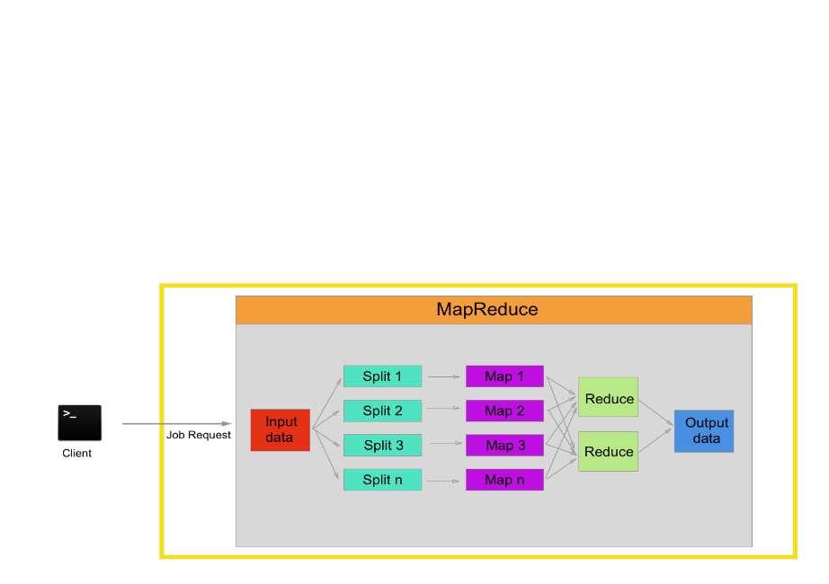
Hadoop Map/Reduce

Slide 17
Apache Spark
Open-source
Supports MapReduce – a.k.a. Action Transformation
Lazy (delayed, on demand) evaluation
In-memory storage and computing
Offers APIs in Scala, Java, Python, R, SQL
Built-in libraries

Slide 18
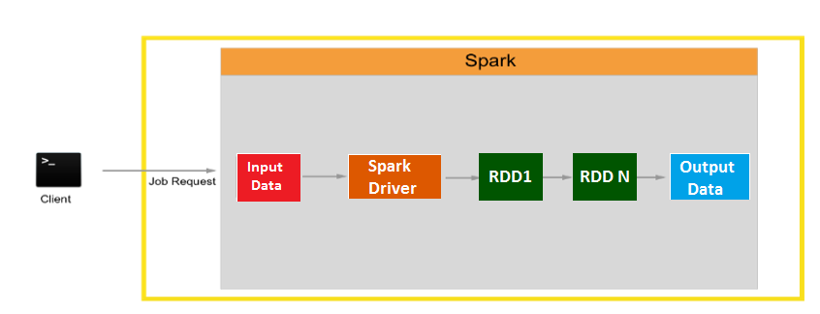
Apache Spark
RDD – Resilient Distributed Dataset

Slide 19
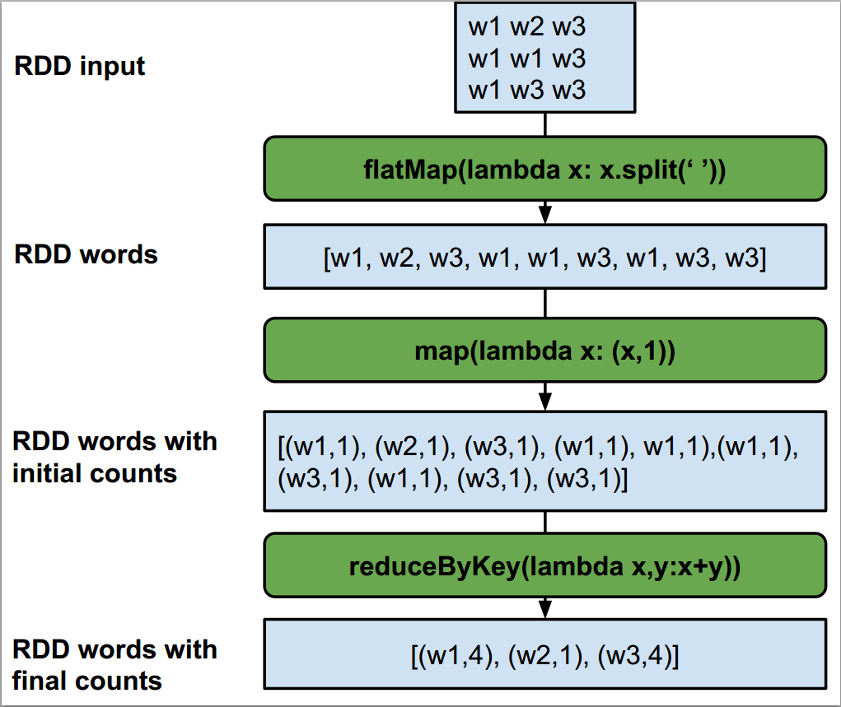
Notes:
Another example for spark – yet to add

Slide 20
Hadoop or Spark?
NOT mutually exclusive
Database – HDFS or others
Rate of processing data
Third-party machine-learning library
Non-commercial, open-source

Slide 21
Initial Tests, Recommender and Clustering
Initial Tests
  Word Count
  Matrix Multiplication
Recommender Systems
K-Means Clustering

Slide 22
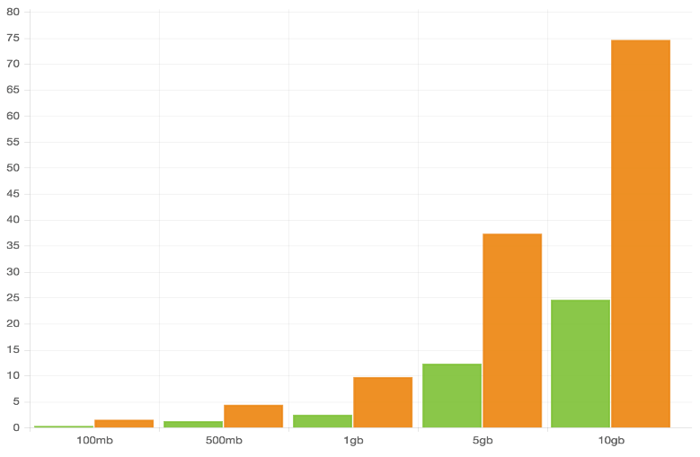
Word Count (Cluster)
Spark
Hadoop
Time (in minutes)
Size of the text file

Slide 23
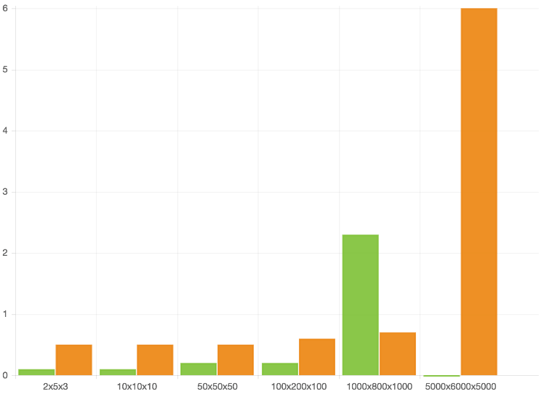
Matrix Multiplication (Cluster)
Spark
Hadoop
Time (in minutes)
Size of the Matrices
Notes:
Feasibility is the word to use – Hadoop or spark

Slide 24
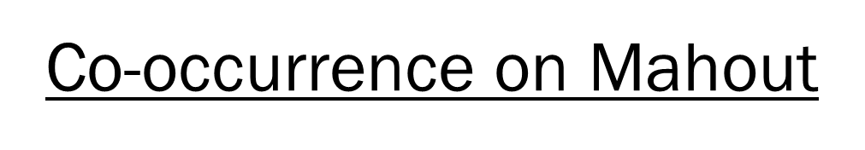
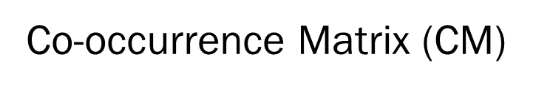
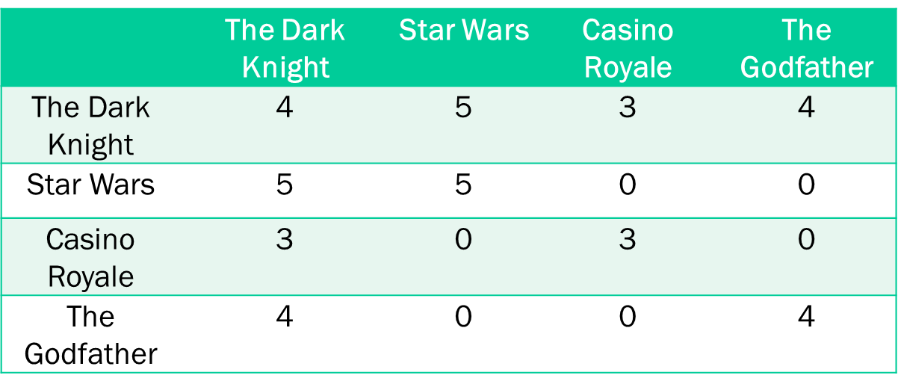
Movie Recommender-Hadoop
“ I have watched the same movies as you. What other movies have you watched that I have not?”

Slide 25

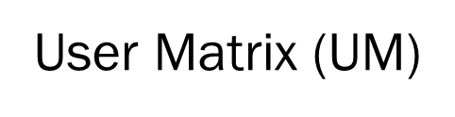
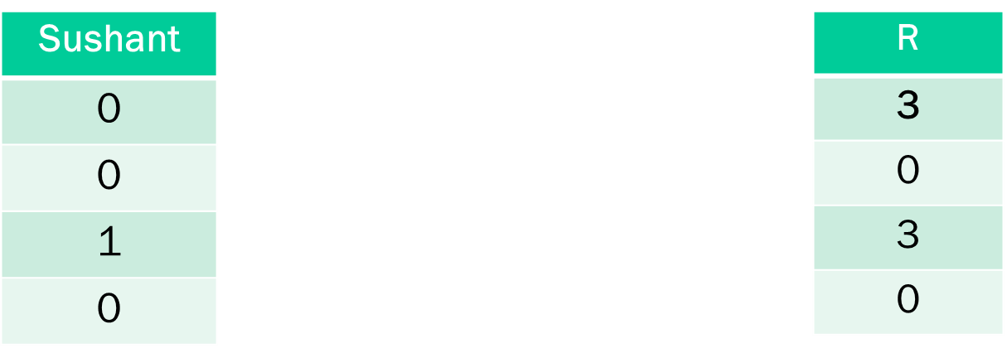
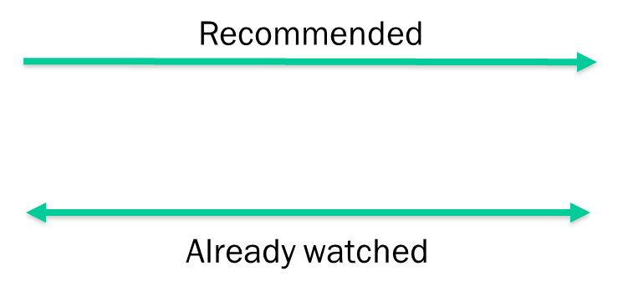

Movie Recommender-Hadoop

Slide 26
Movie Recommender-Spark
Collaborative Filtering:
  “I like the same movies that you like. What other movies did you like that I haven’t seen?”
Alternating Least Squares (ALS):
  “Effective and Scalable method of implementing Collaborative Filtering.”

Slide 27
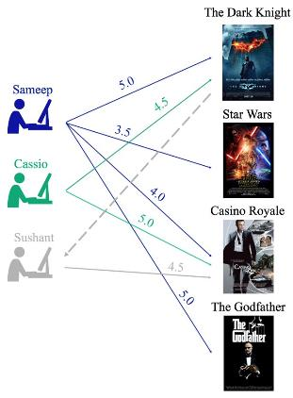
Movie Recommender-Spark

Slide 28
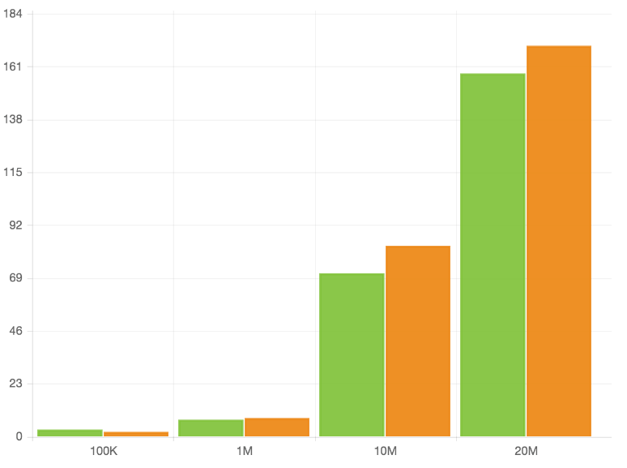
Recommender Comparison
Spark
Hadoop
Time (in minutes)
Number of records in the input file

Slide 29
K Means Clustering
k₁
Y
k₃
k₂
X
Source: www.liacs.nl/~putten/edu/dbdm05/Lecture3.ppt
Notes:
This is only 2-dimensional, but in reality its multi-dimensional
For example for a loan, we have age, credit history, gender, number of children, marital status, previous loans etc.

Slide 30
Clustering Applications
Who decides whether or not you get the loan that you applied for?
  Approved Loan Cluster
  Rejected Loan Cluster
  Doubtful Loan Cluster
Marketing:
  Helps marketers discover distinct groups in their customer bases
  Develop targeted marketing programs for each group
http://www.stat.columbia.edu/~madigan/W2025/notes/clustering.pdf

Slide 31
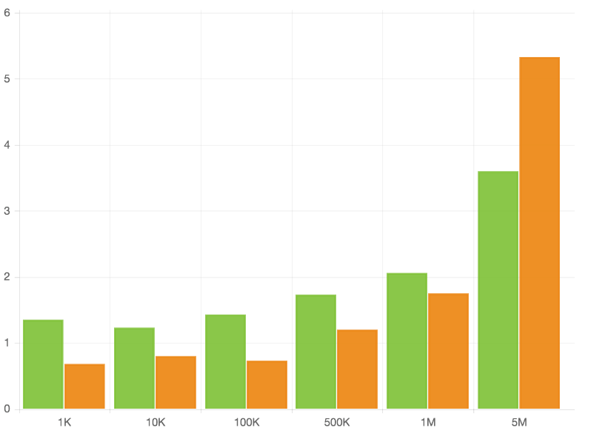
Clustering Comparison
Spark
Spark
Hadoop
Hadoop
Time (in minutes)
Number of records in the input file

Slide 32
Hadoop or Spark?
(Based on a cluster of 1 M and 2 W)
Hadoop – Huge datasets
Spark – Computational capability
Spark – Degrades on I/O swapping

Slide 33
Technical Challenges
Multiple Reducer Problem
Amount of data
  Co-occurrence algorithm
  Dumping clusters: K-Means
Quality of Recommendations
Notes:
Quality of the choice you get
Wisdom = f(knowledge) = f(choice)
Culture = f(information) = f(truth)
Java – efficiency runs into memory problems
Hadoop/Spark – feasibility
Smart data/mahout/MLlib - quality

Slide 34
General Challenges
Punctuality
Updating Documents after each Iteration
Not able to work from home
Rapidly changing software versions

Slide 35
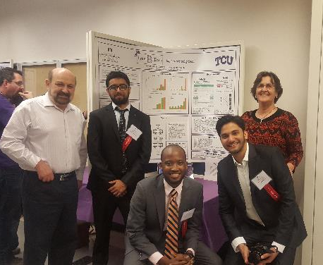
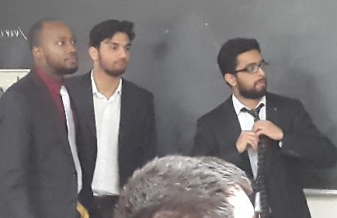
Presentations
TCU Student Research Symposium
North Texas Area Student Conference
Notes:
Add some photos of srs and ntasc presentation

Slide 36
Acknowledgements
Project Client
  Dr. Antonio Sanchez
Faculty Advisor
  Dr. Donnell Payne
Systems Admin
  Mr. Billy Farmer
Advice on Complex Algorithms
  Dr. Eric Hanson
Notes:
Add their roles

Slide 37
Recommended Movies

Slide 38
Thank you!
Questions
Notes:
Maybe add videos
http://www.slideshare.net/imcsummit/imcs2015-1-devspark-after-dark

